Slide 1
Low Power 10T-SRAM Design for In-Memory Computing with Leakage Current Reduction by High-Vt, Transistor Sizing, Transistor Stacking and Negative Vgs Techniques
High-vt on SRAM
Voltage reduction on Vdd of SRAM and Precharge circuit
Word-line overdrive to strengthen access transistor
Subthreshold write operation with charge sharing (write assist by bitlines)
Resized SRAM transistors to the minimum value (everything 120n with high Vt)
Transistor stacking on ground path
Negative Vgs due to the high voltage on ground path driven by an inverter for read
EE577a Final Project
Ziqiao Fan, Mustafa Altay Karamuftuoglu, Zeyu Xie, Chunxiao Lin

Slide 2
Work Distribution
10T SRAM, precharge and write driver circuit design and initial simulation (Chunxiao, Zeyu, Ziqiao, Mustafa)
Decoder design and initial simulation (Zeyu)
Sense amplifier design and initial simulation (Chunxiao, Ziqiao)
10T SRAM and Sense amplifier layout (Mustafa)
Multi-vt implementation and resizing on SRAM and Sense Amplifier (Chunxiao, Zeyu, Ziqiao, Mustafa)
Vdd voltage reduction implementation (Ziqiao, Mustafa)
Negative Vgs on read, transistor stacking and logical effort for decoder (Chunxiao, Zeyu)
Test vector preparation for all phases (Chunxiao, Zeyu, Ziqiao, Mustafa)
Final simulation with all patterns (Chunxiao, Zeyu, Ziqiao, Mustafa)
Documentation for all phases (Chunxiao, Zeyu, Ziqiao, Mustafa)
Zoom Link:

Slide 3
Overall Block Diagram for In-Memory Computing
Decoder Mode
and Selection
Decoder
WL activation logic and low power technique circuits
Sense amplifier and latch
Write Driver
Pre-charge
SRAM
DFF

Slide 4
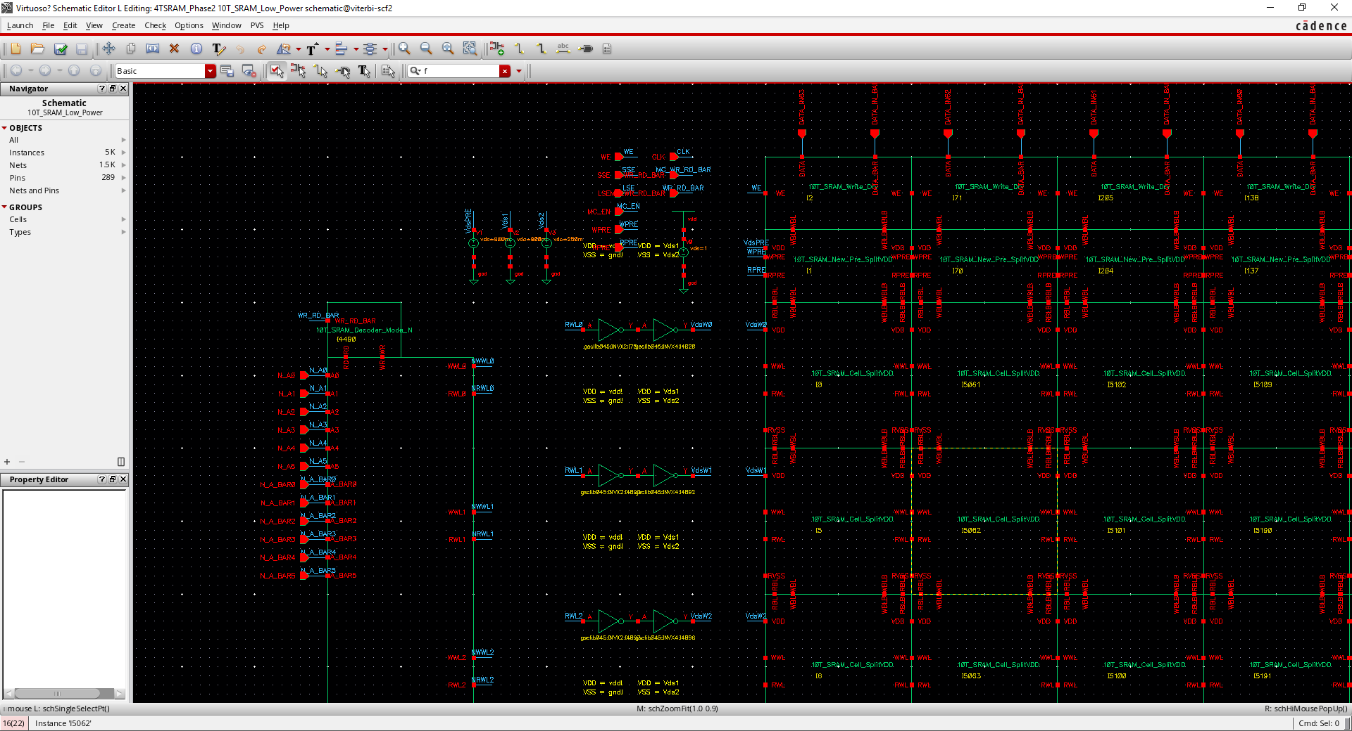
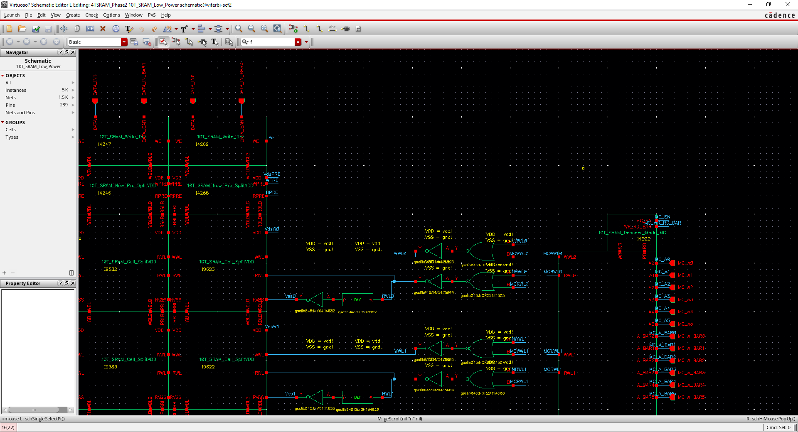
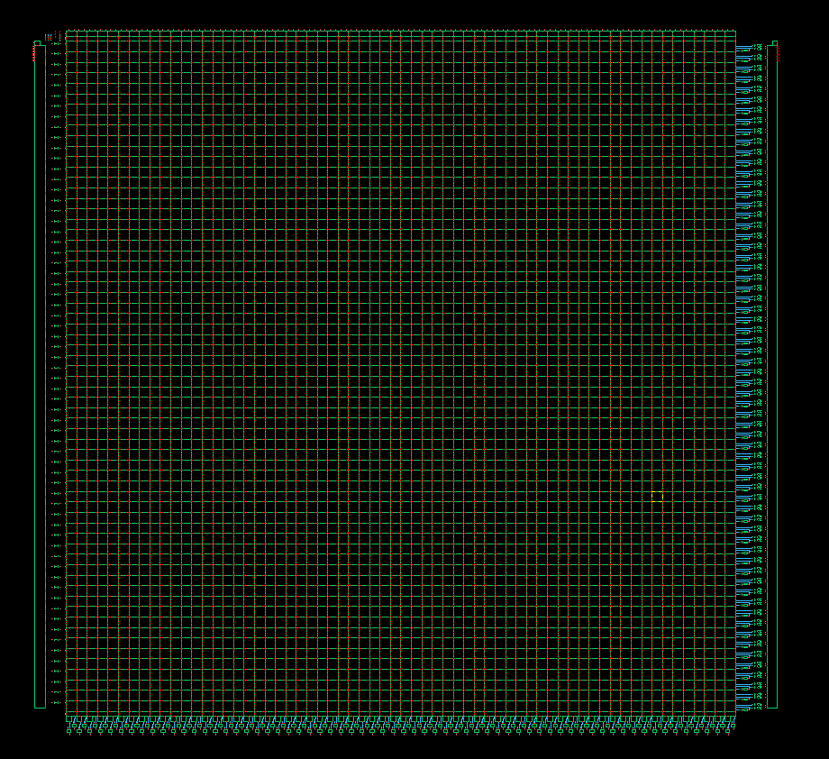
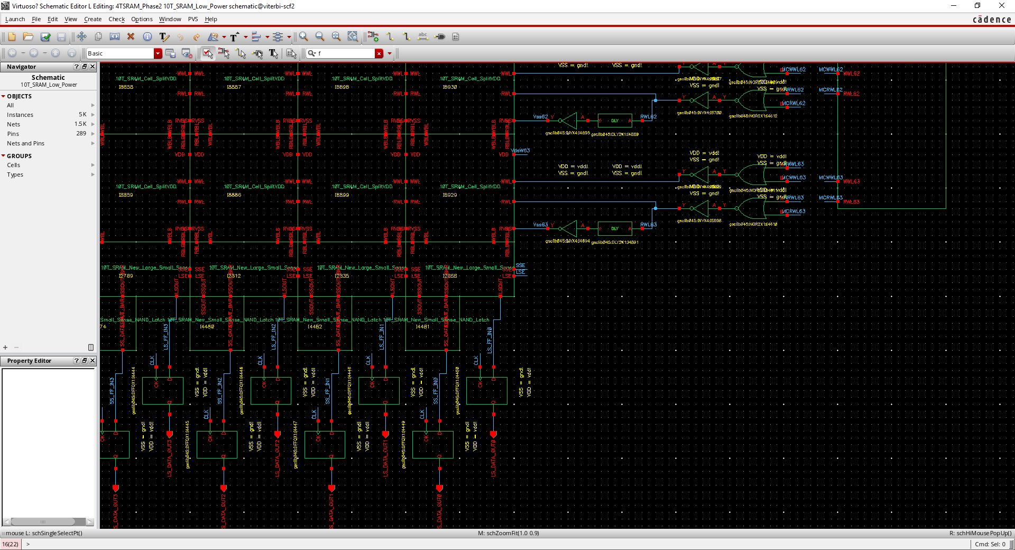
Overall Schematic for In-Memory Computing Low Power Techniques
Decoder Mode
Write Driver
Read
Ground
Path
WL
Activation
Pre-charge
Decoder Mode
SRAM VDD
Selection
SRAM
Decoder
Decoder
DFF

Slide 5
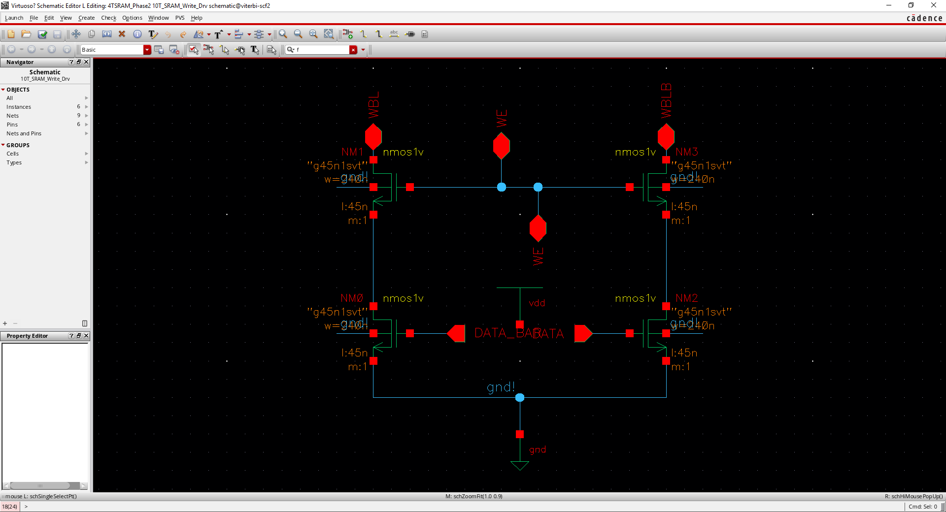
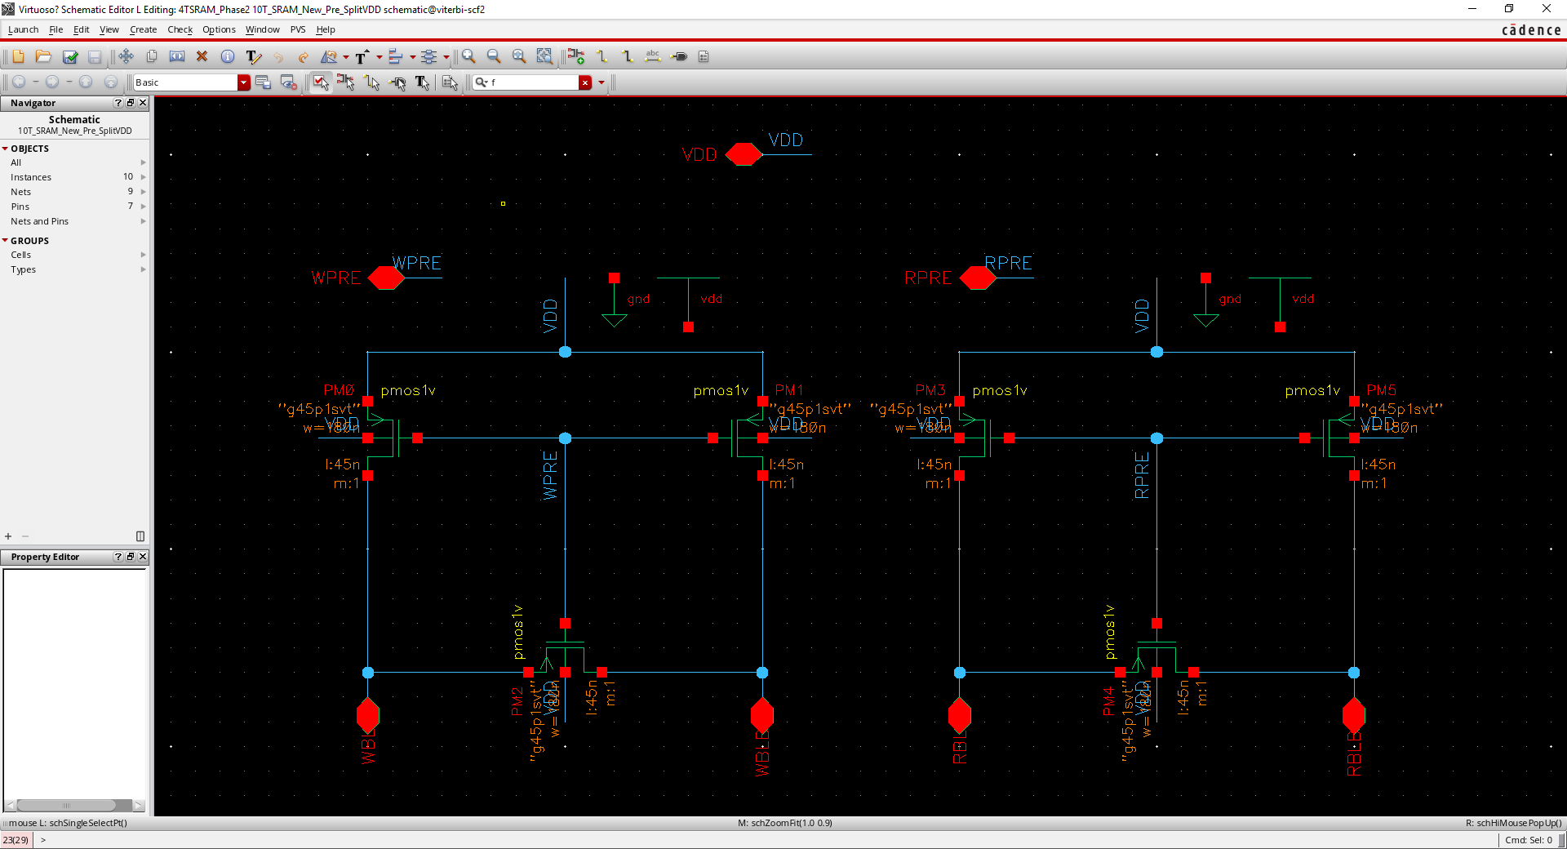
Overall Schematic for In-Memory Computing Low Power Techniques
Write Driver
Pre-charge

Slide 6
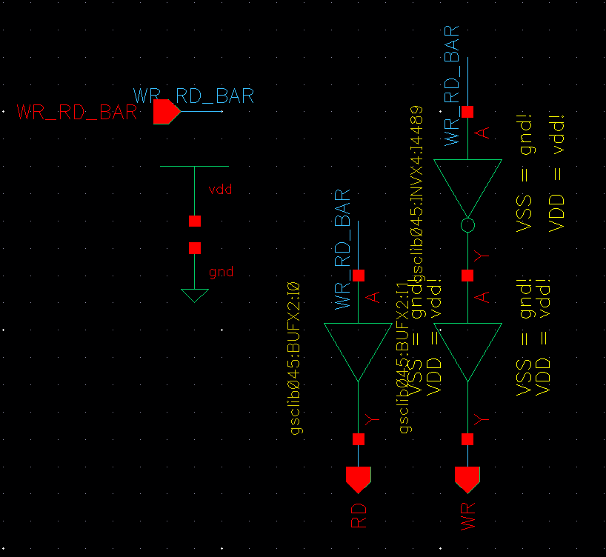
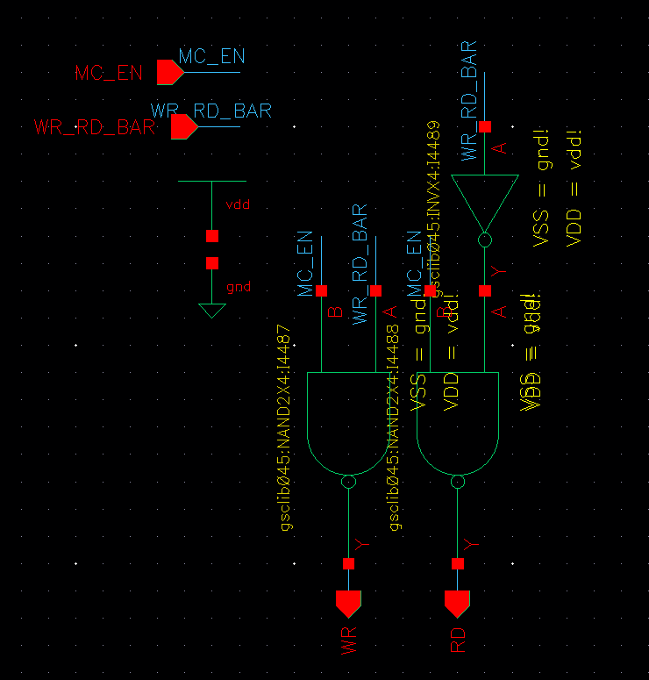
Overall Schematic for In-Memory Computing Low Power Techniques
Mode Select (Normal)
Mode Select
(In Memory Compute) Mode

Slide 7
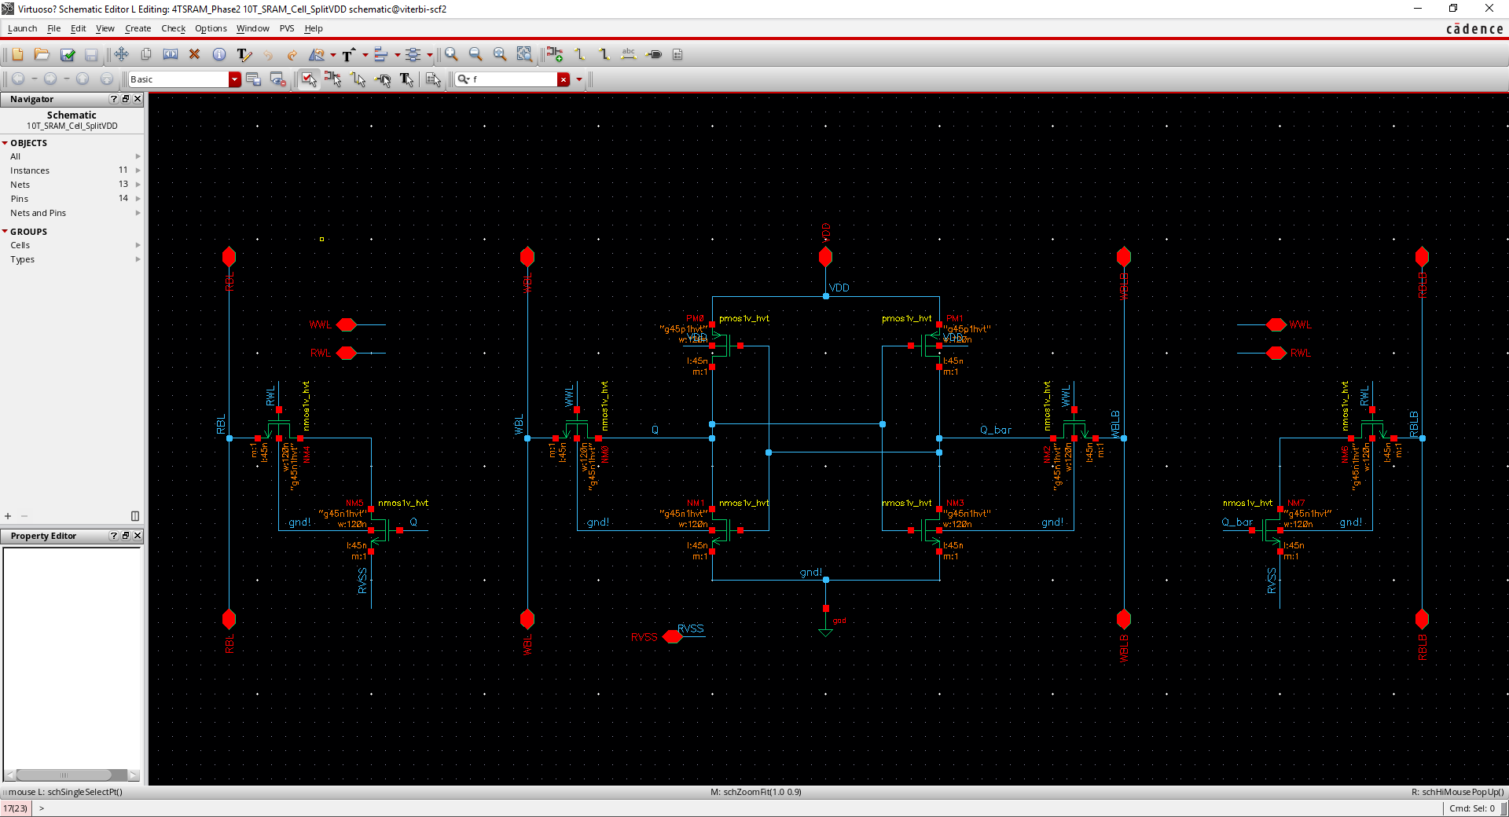
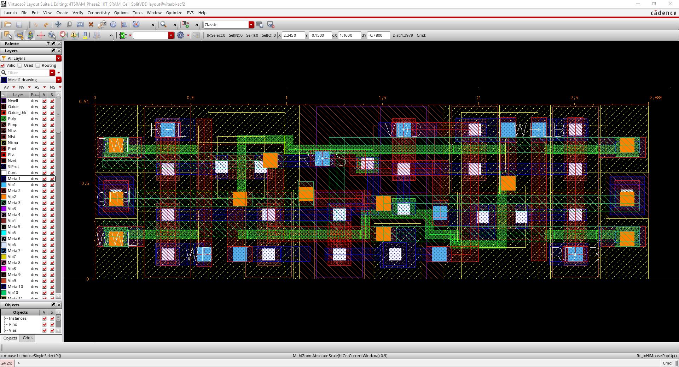
Bit-Cell Design
Area: 0.91 x 2.885 = 2.625

Slide 8
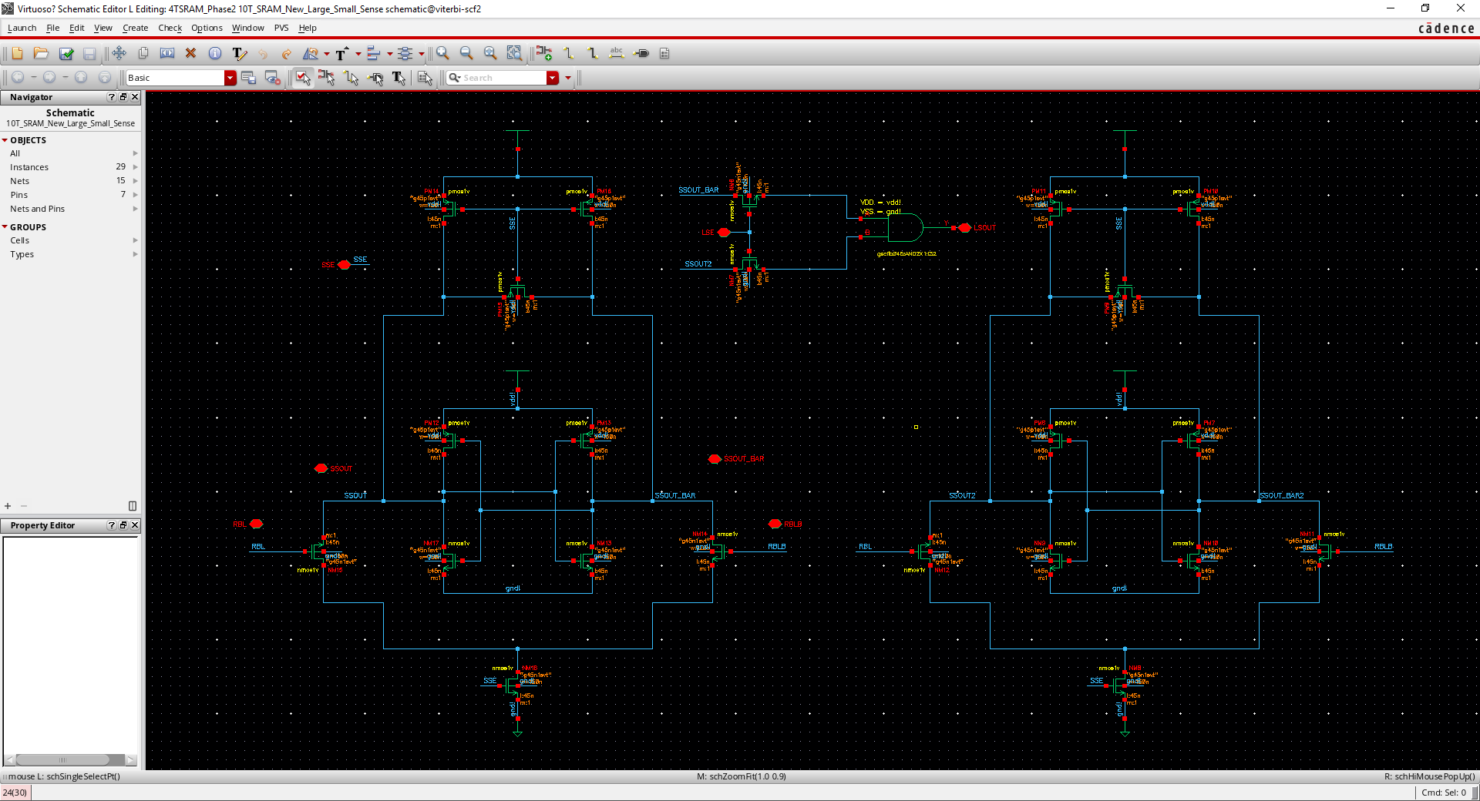
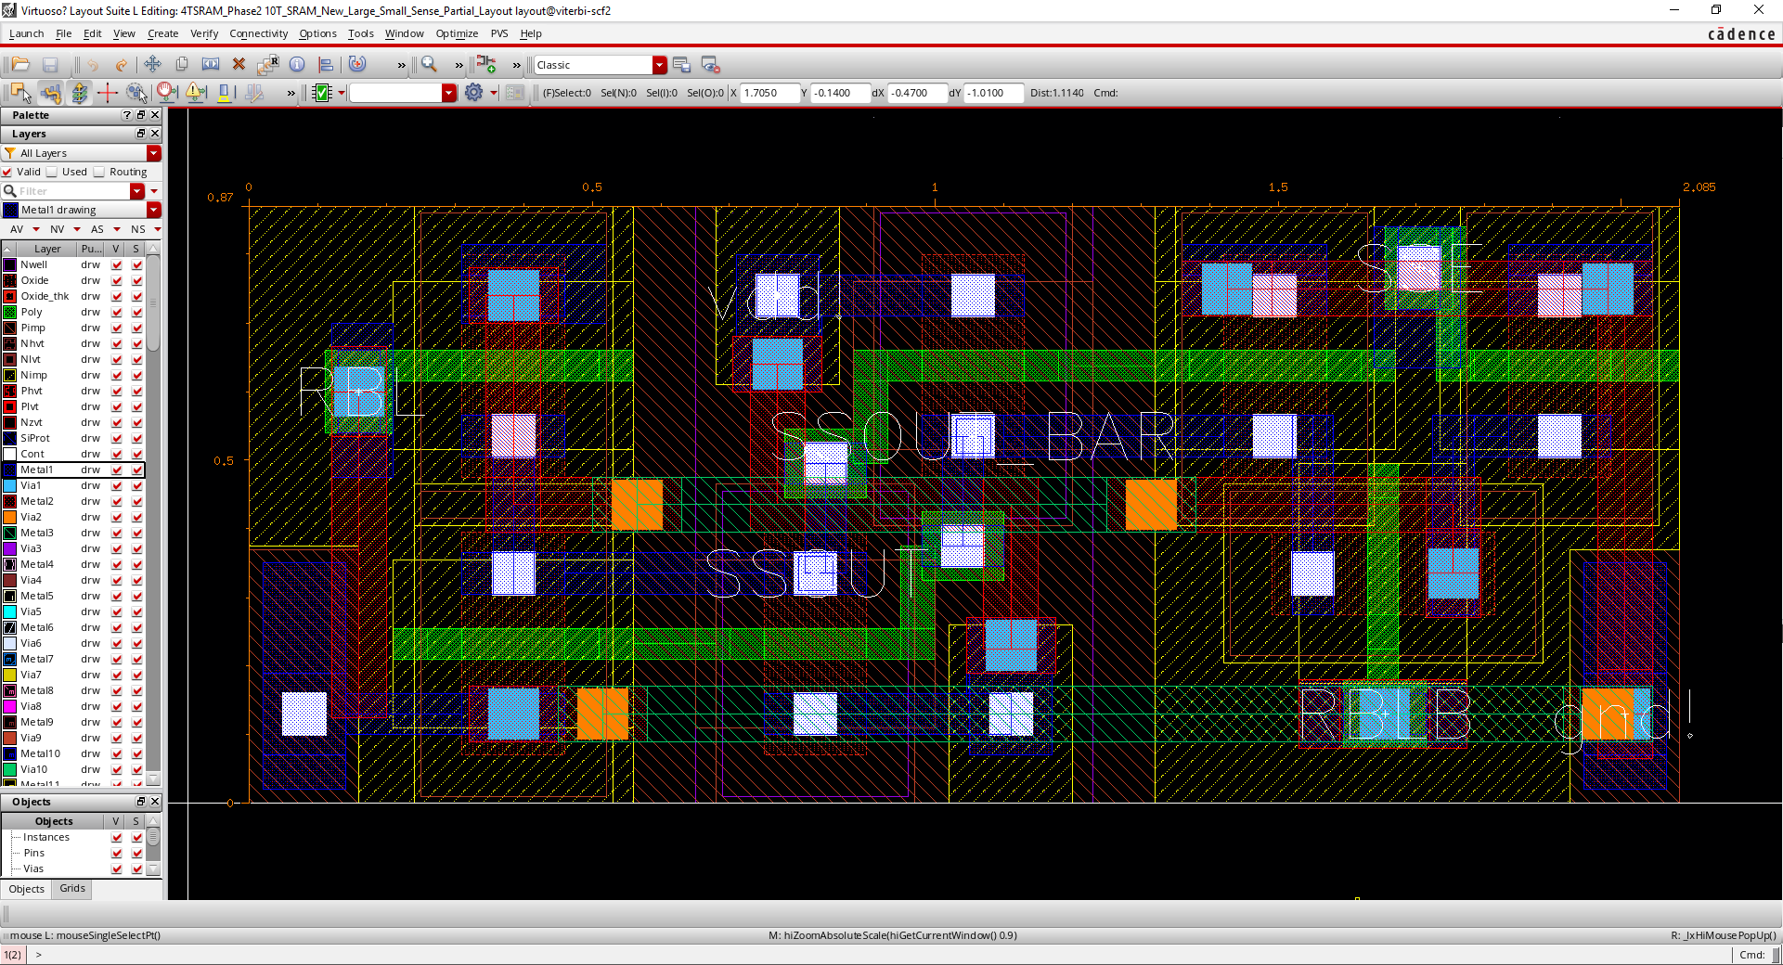
Sense-Amp Design
Area: 0.87 x 2.085 = 1.814
We make the design with thin cell layout to be able to overlap it but we didn’t consider this overlapping feature for the area estimation.

Slide 9
Area Estimation
Overall Area Estimate = Area of one bit-cell X (64x64) + Area of one sense amp X (64) + Area of one output latch X (64)
Area of bit-cell calculation:
From 1 bit cell non-overlapping: 64 x 64 x 0.91 x 2.885 = 10753.434 using as a reference.
From 2x2 bit cells non-overlapping: 32 x 32 x 1.56 x 5.55 = 8865.792 will be 82% of the reference and 18% area is saved.
From all overlapping cells: 1 x 1 x 41.86 x 170.78 = 7148.851 will be 66% of the reference and 34% area is saved.
Area of sense amp calculation:
From 1 sense amp non-overlapping: 64 x 0.87 x 2.085 = 116.093
Area of output latch calculation:
From 1 output latch non-overlapping: 64 x 2 x 1.9 x 0.72 = 175.104
Overall Area Estimate (by 2x2 cells) = 8865.792 + 116.093 + 175.104 = 9156.989
Overall Area Estimate (by all overlapping cells) = 7148.851 + 116.093 + 175.104 = 7440.048
The units for the length is um and for the area is um x um.

Slide 10
Minimum Size SRAM Transistors with Multi-VT (High VT) Implementation

Slide 11
VDCL: VD Cell Lowering

Slide 12
Subthreshold Write Operation with Charge Sharing Boost

Slide 13
WLOD: Wordline Over Drive

Slide 14
Negative Vgs + Transistor Stacking
During hold and write, Vgs = -0.75 V

Slide 15
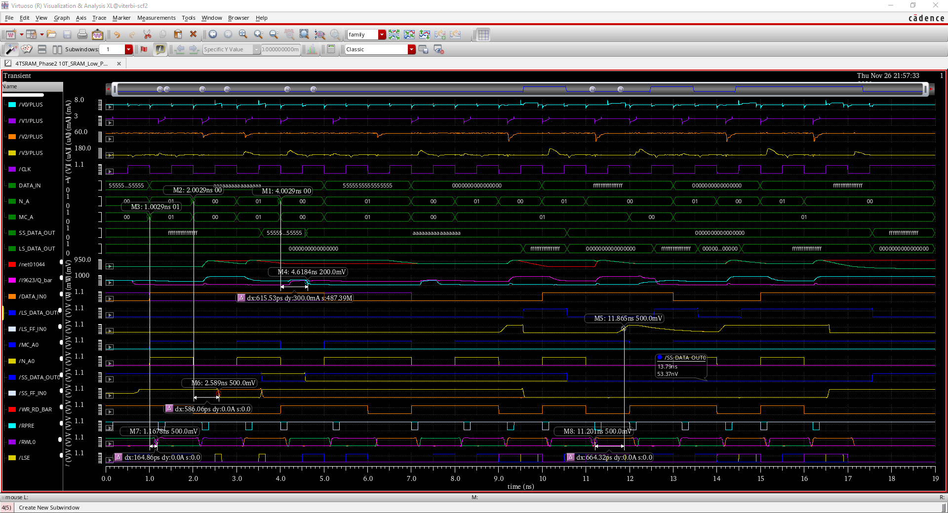
Low Power Technique, In-Memory and Normal Operations: Waveforms
Max Write Frequency: 1.63 GHz
Max Read Frequency: 1.71GHz
Max IM Frequency: 1.5 GHz
Notes:
Functional Waveform: Normal Read and Write with Low Power Techniques

Slide 16
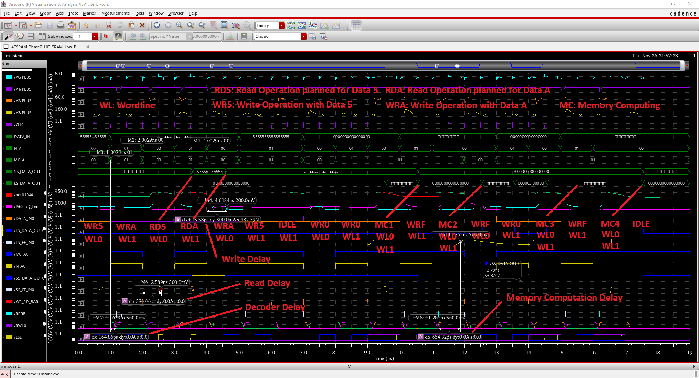

Slide 17
Challenges Faced and Future Work
Vector file which makes the proper timing for the design was hard to handle
SRAM sizing with low power techniques (especially high-Vt)
Lowing down the power consumption of the peripheral circuits. We have different DFFs for normal and in-memory computing operations. We can use multiplexer and use only one set of DFFs.
Improving the clock frequency
We would like to collaborate to find a way to decrease the peripheral circuit power consumption.

Slide 18
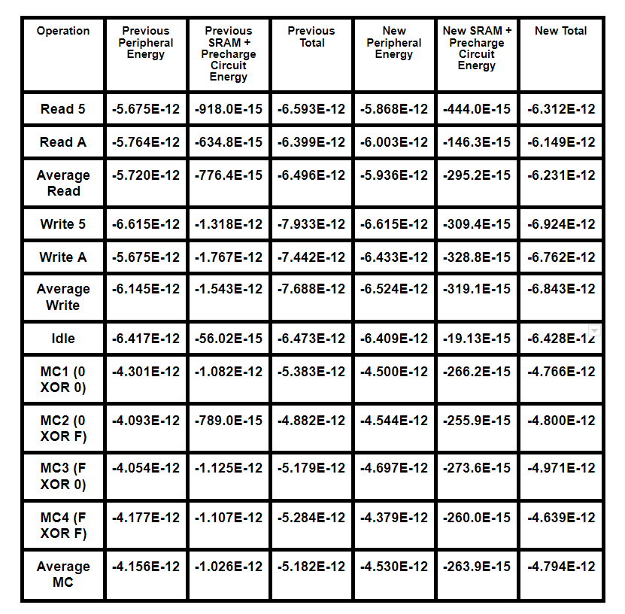
Energy and Power Numbers
Average Read
from -776.4E-15 to -295.2E-15
62% Saved
Average Write
from -1.543E-12 to -319.1E-15
80% Saved
Average MC
from -1.026E-12 to -263.9E-15
74% Saved
Since we operate at 1 GHz, we can divide each of these energy values with 1ns (1E-9)

Slide 19
Power Performance Area (PPA) Result
Average Read
|-295.2E-6| (W) x 1E+9 (Hz) x 7440.048E-12 (m²) = 2.20E-3 (W.Hz.m²)
Average Write
|-319.1E-6| (W) x 1E+9 (Hz) x 7440.048E-12 (m²) = 2.37E-3 (W.Hz.m²)
Average MC
|-263.9E-6| (W) x 1E+9 (Hz) x 7440.048E-12 (m²) = 1.96E-3 (W.Hz.m²)

Slide 20
Appendix

Slide 21
10T SRAM Schematic Big and small sense amplifier schematic
Precharge circuit schematic Write driver schematic

Slide 22
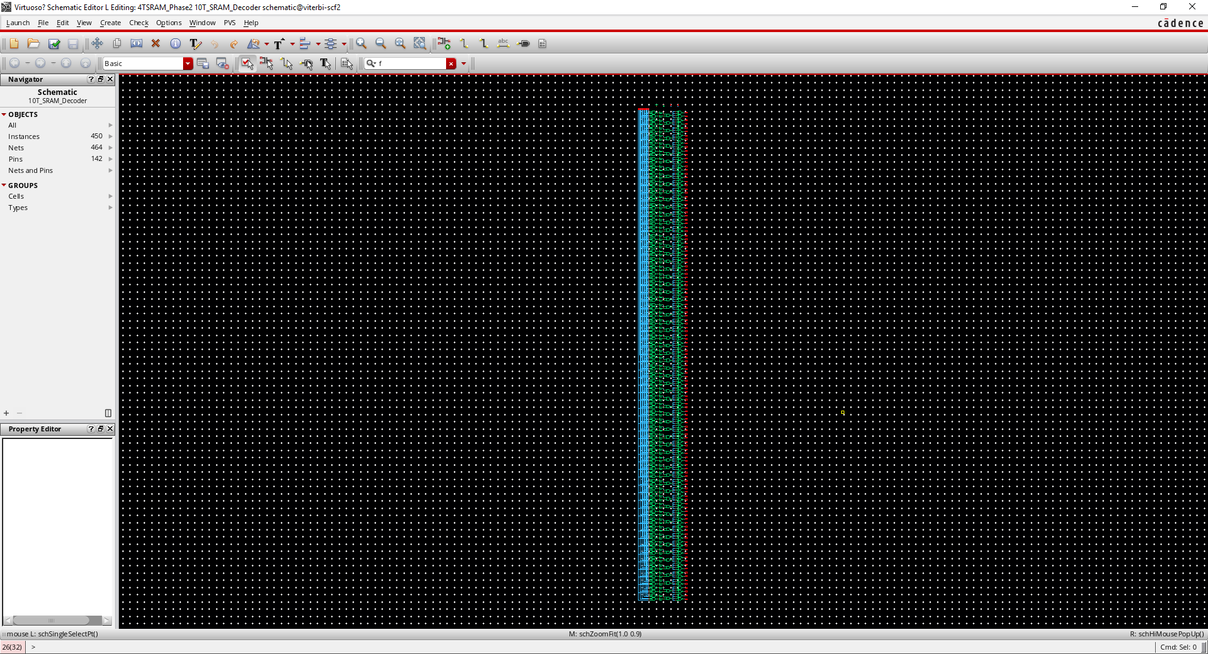
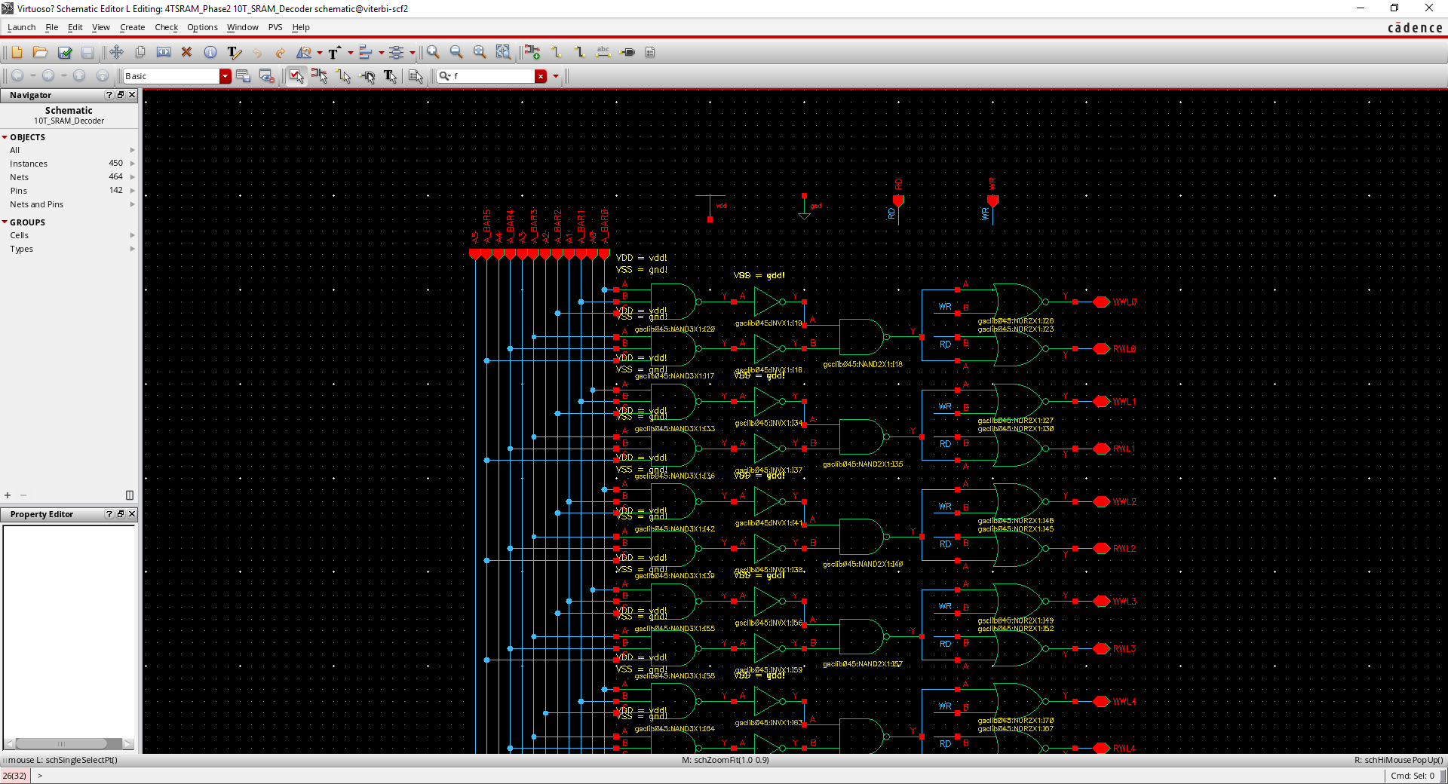
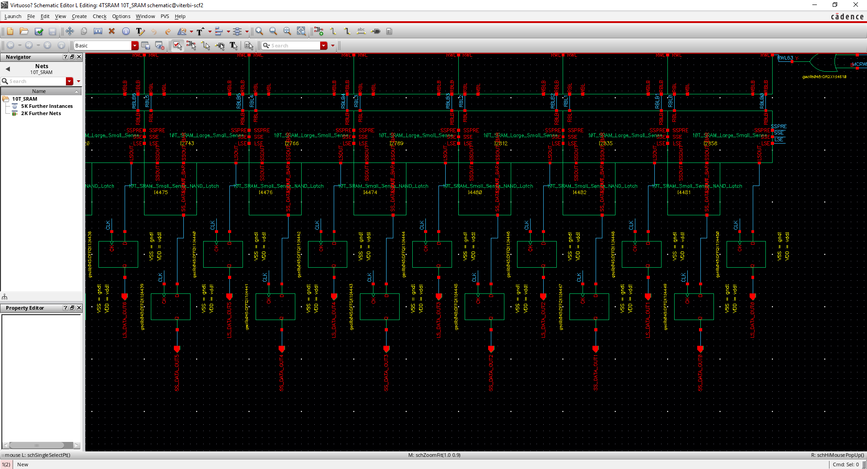
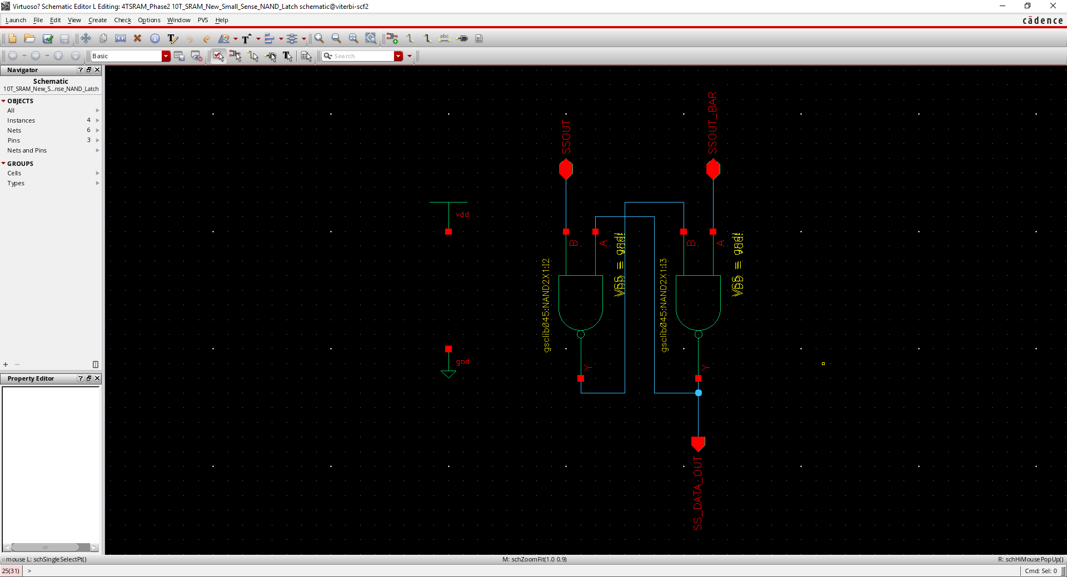
Row decoder schematic Zoomed decoder schematic
DFF schematic Latch schematic

Slide 23
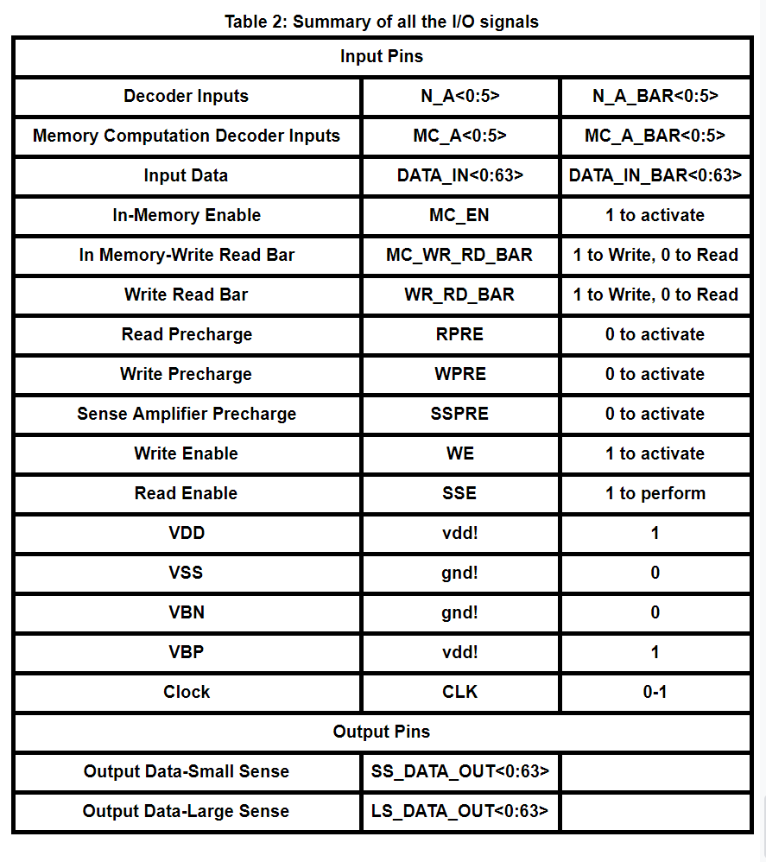

Slide 24
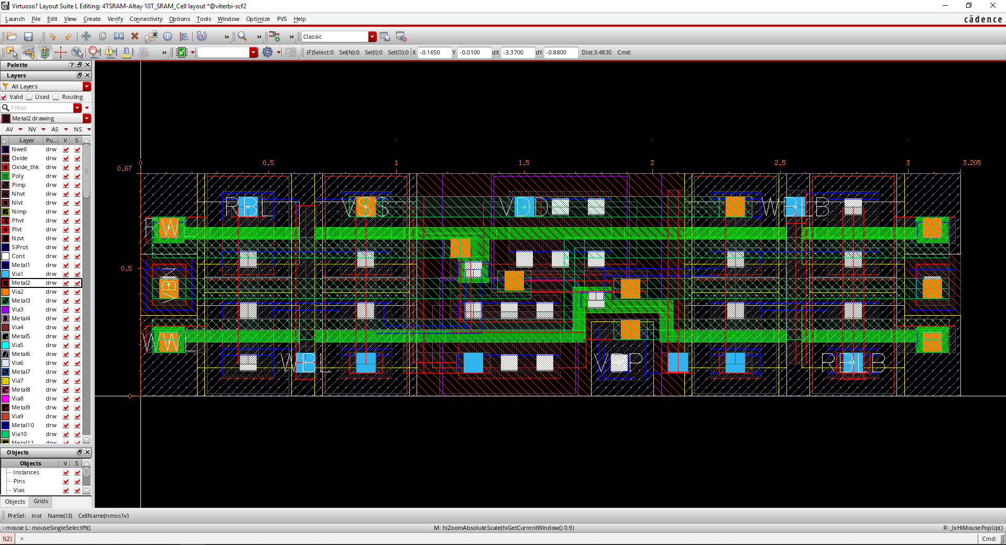
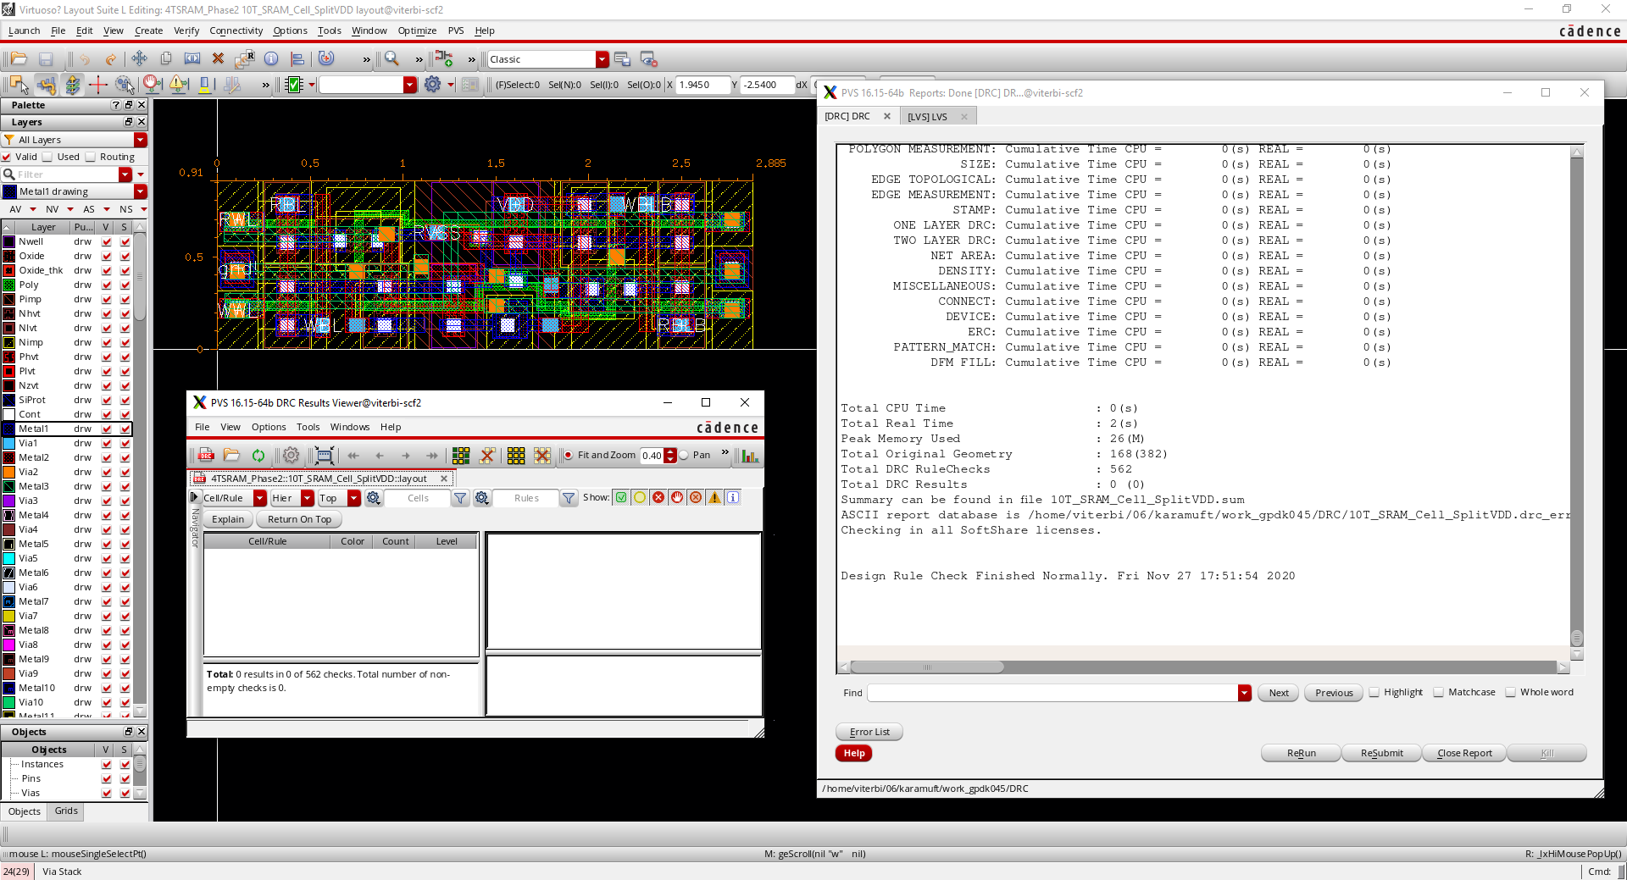
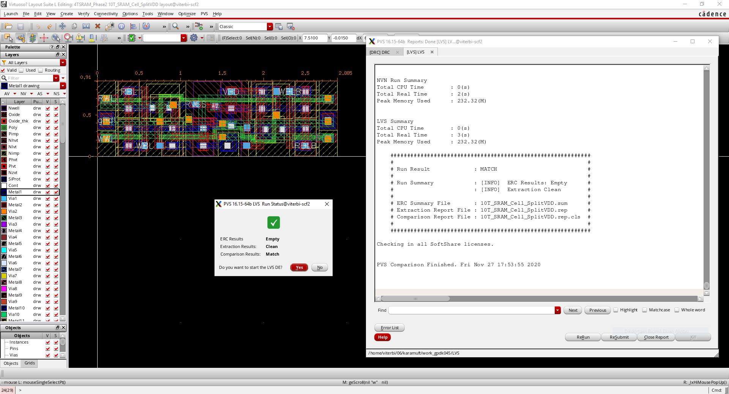
Bit-cell Layout, DRC, LVS
Area: 0.87 x 3.205 = 2.788
Area: 0.91 x 2.885 = 2.625
Bit-cell layout old version Bit-cell layout new version
Bit-cell DRC Bit-cell LVS

Slide 25
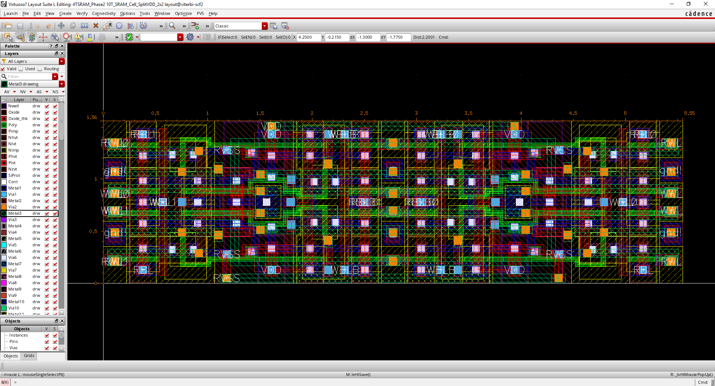
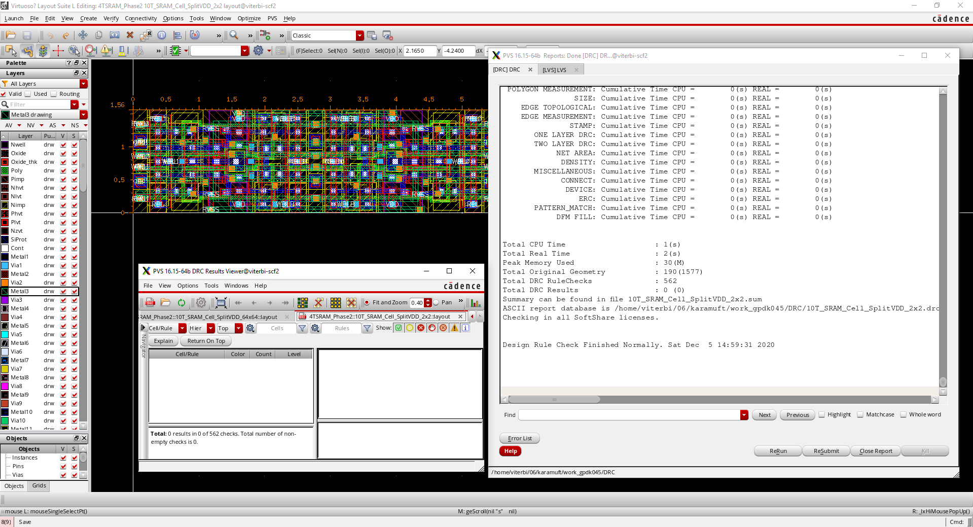
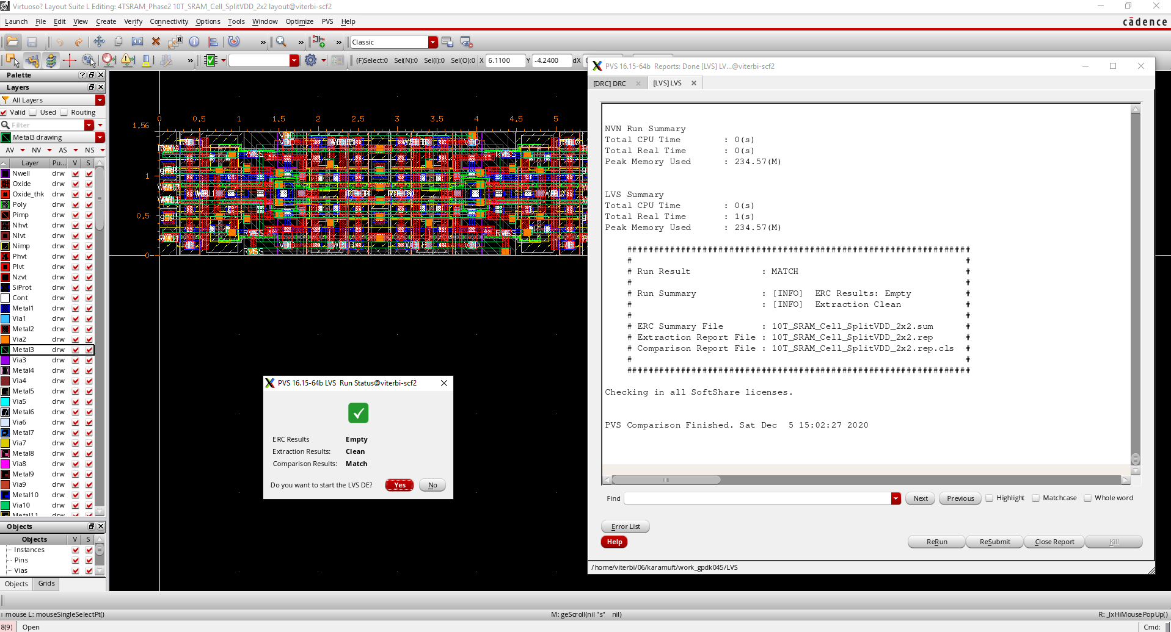
2x2 Bit-Cell Design
32 x 32 x 1.56 x 5.55 = 8865.792 will be 82%
18% area is saved.

Slide 26
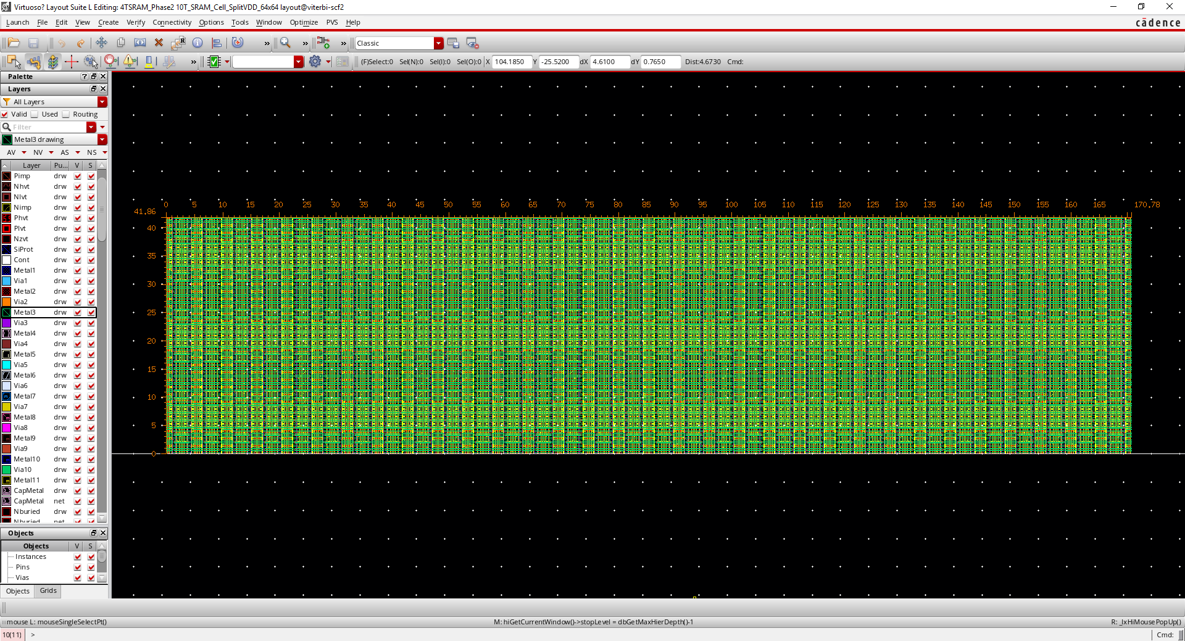
64x64 SRAM Design
Total Area: 1um x 1um x 41.86um x 170.78um = 7148.851 um x um
Non-Overlapped: 64um x 64um x 0.91um x 2.885um = 10753.434 um x um
Total area saved: 34% area is saved (Compared to the reference)

Slide 27
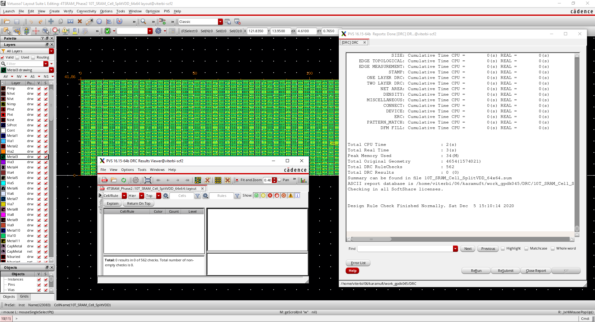

Slide 28
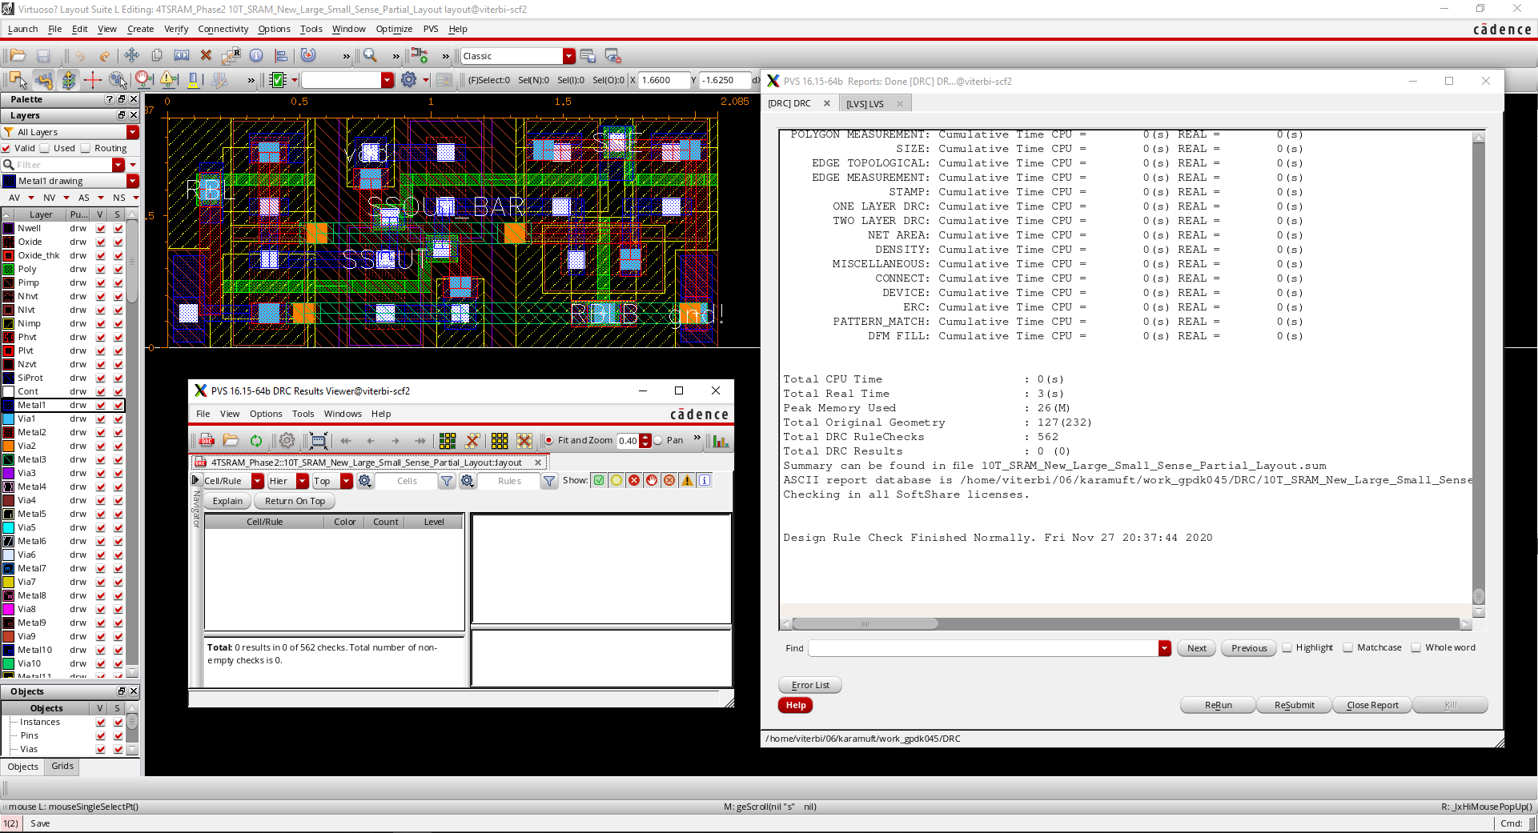
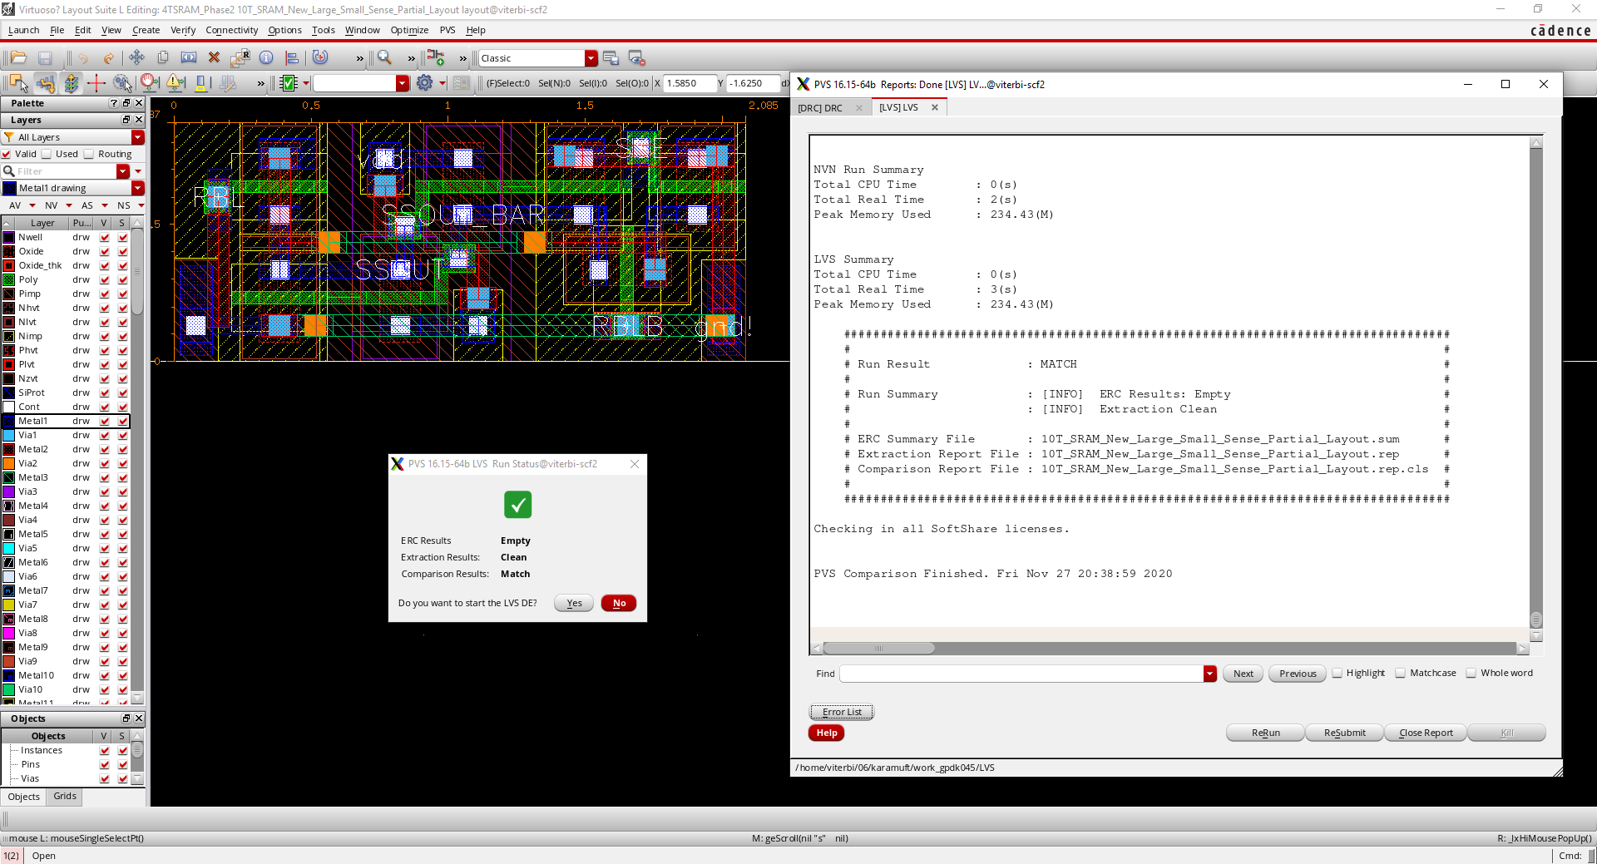
Sense Amplifier Layout, DRC, LVS
Area: 0.87 x 2.085 = 1.814
Sense amplifier layout Sense amplifier DRC
Sense amplifier LVS

Slide 29
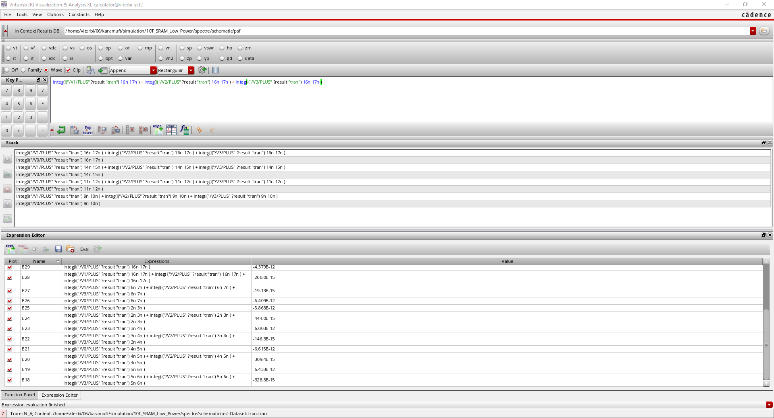
Low Power

Slide 30
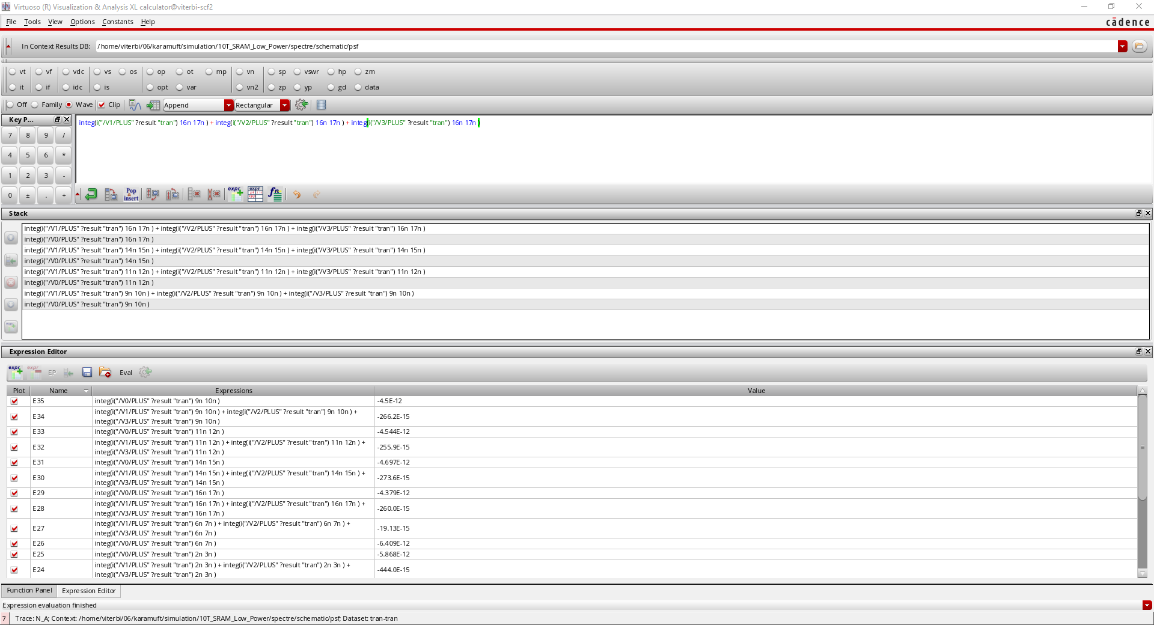
Low Power

Slide 31
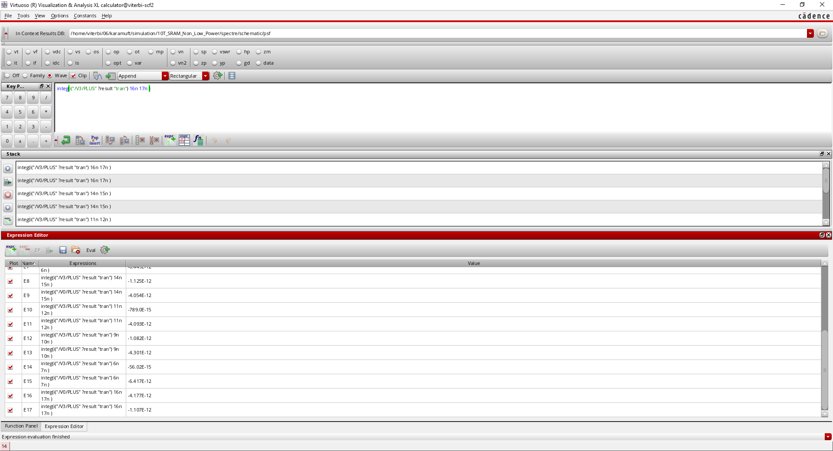
No low power

Slide 32
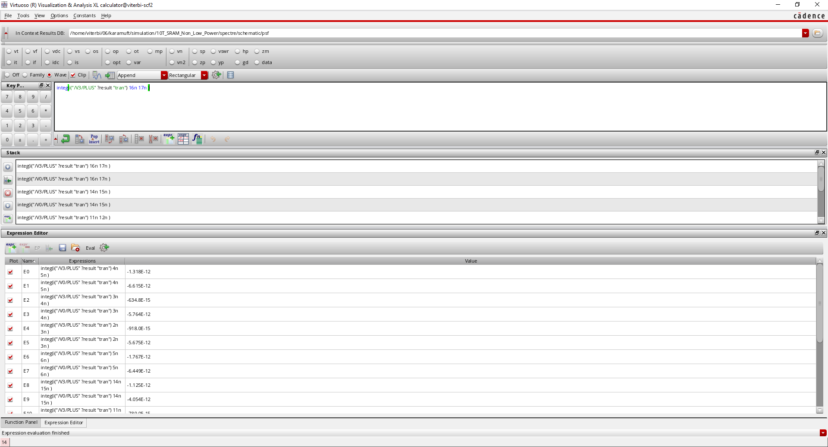
No low power

